Slide 1


Airbnb Trends Analysis
by Smit Pancholi
Visualization of Complex Data Project

Slide 2

01.
Introduction
05.
Conclusion
Content
02.
Dataset Description
06.
Dashboard (GCP)
03.
Data Preprocessing and PCA
04.
Data Visualization

Slide 3


INTRODUCTION
What is Airbnb?
Airbnb: Global online marketplace.
Enables listing, finding, and booking accommodations.
Offers diverse options.
Primarily for short-term stays
01

Slide 4




DATASET DESCRIPTION
NYC Airbnb accommodations
Observations: 102,600
Numerical columns: 27
Categorical columns: 17
02

Slide 5
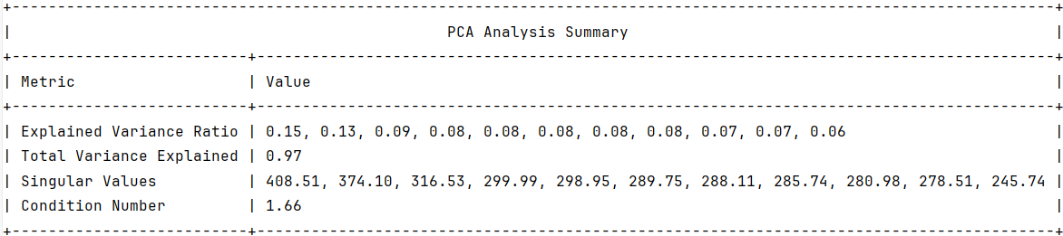
Data Preprocessing and PCA
Removed Nan values.
Removed duplicate values.
Made corrections like brookln to Brooklyn.
Corrected typos and inconsistent capitalization.
03

Slide 6
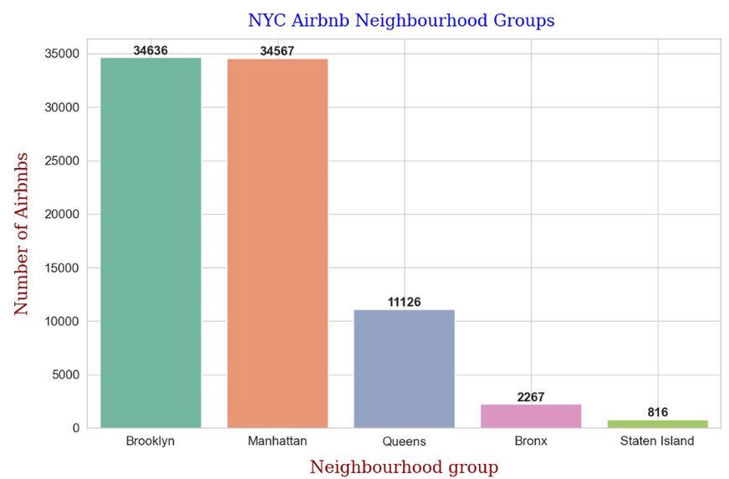
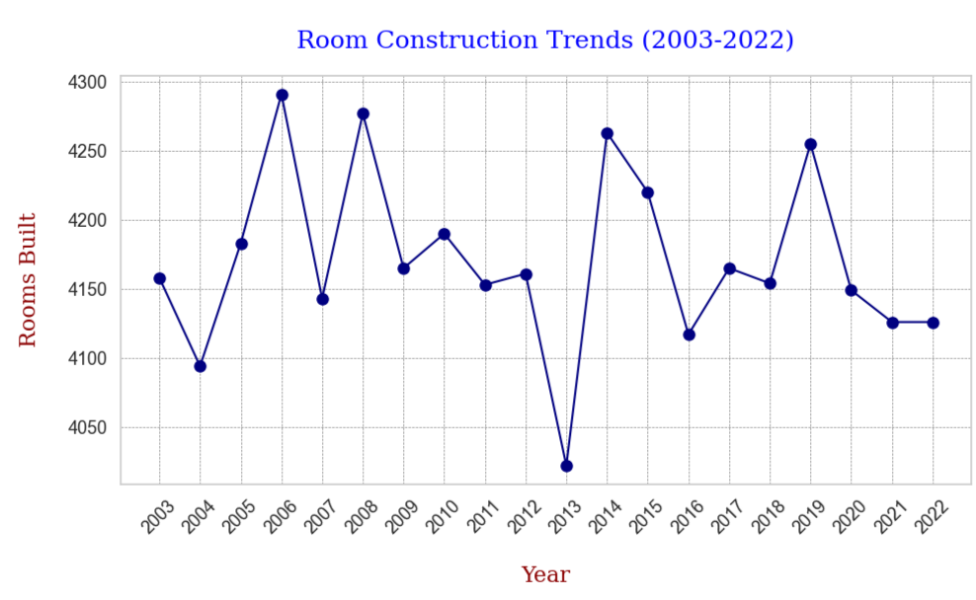
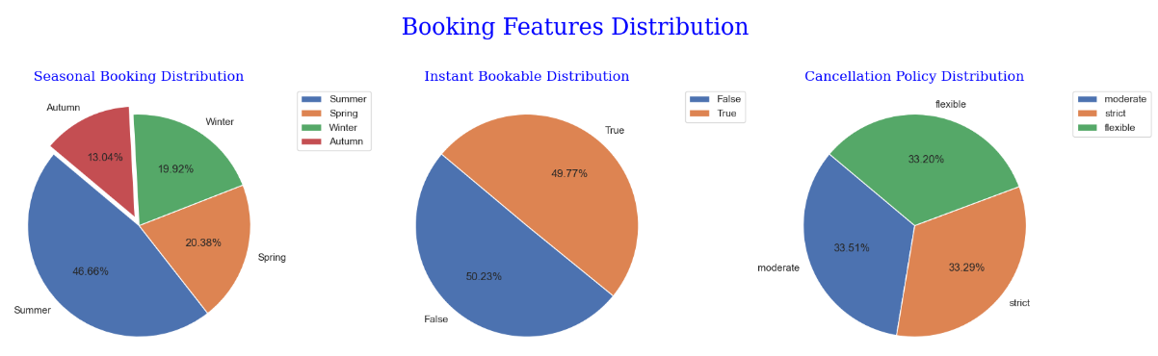
Data Visualization
05

Slide 7
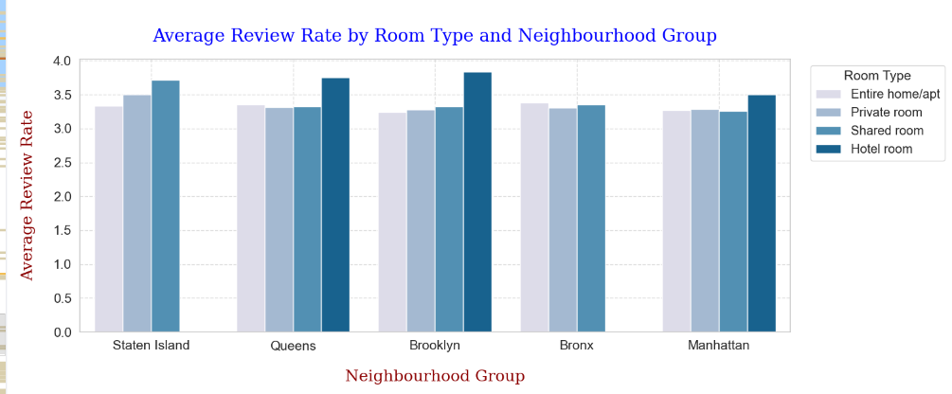
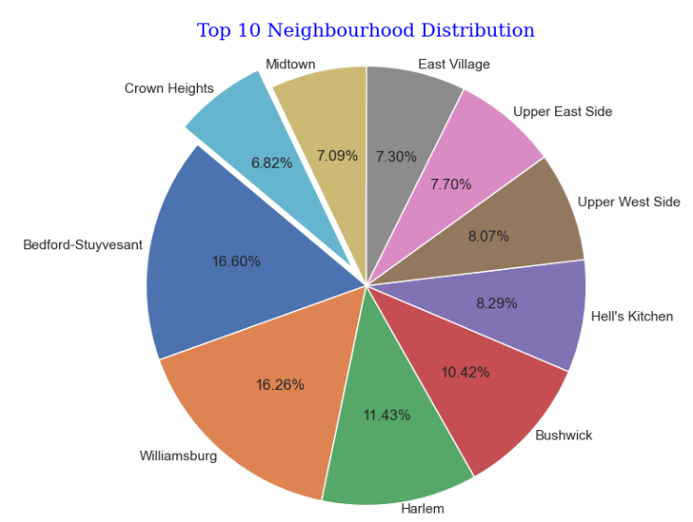
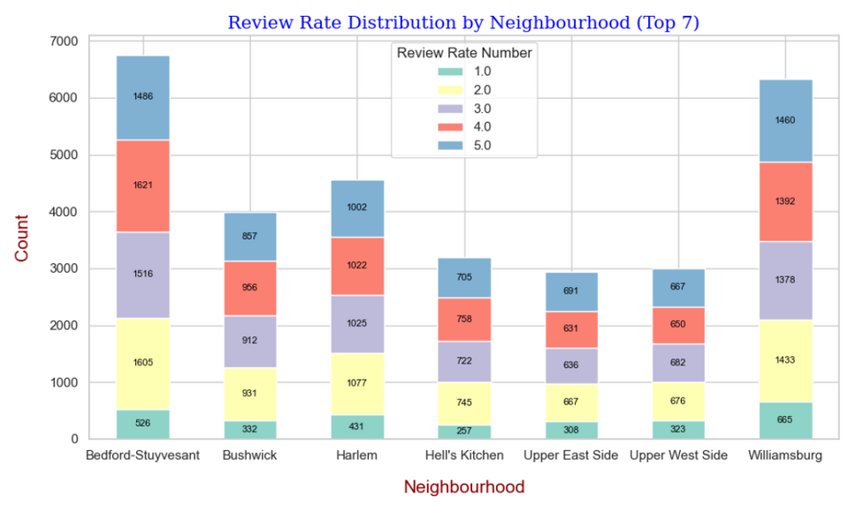
06

Slide 8
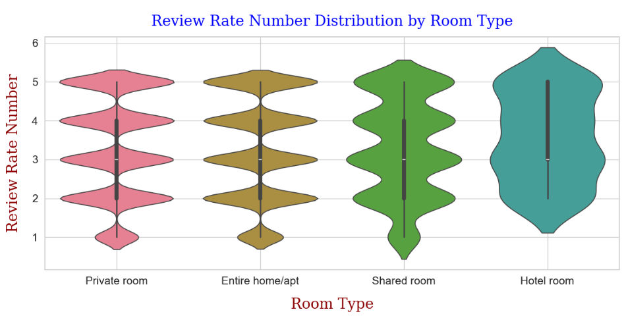
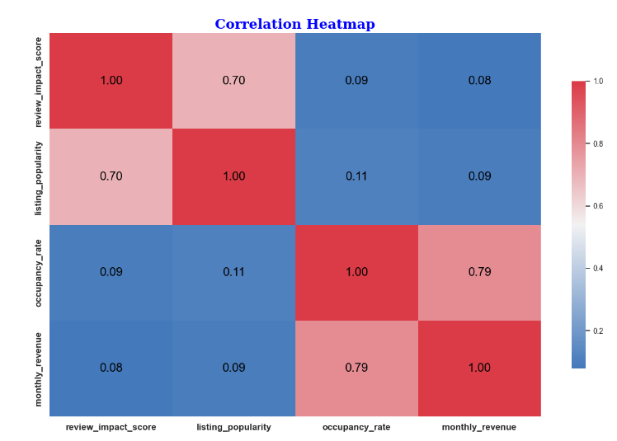
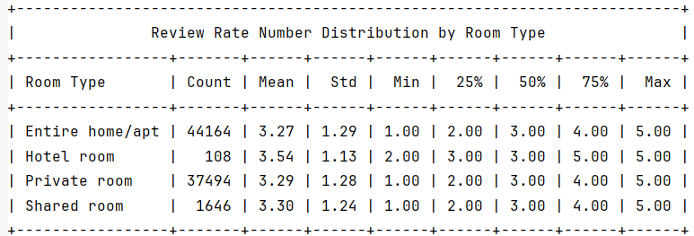

Slide 9
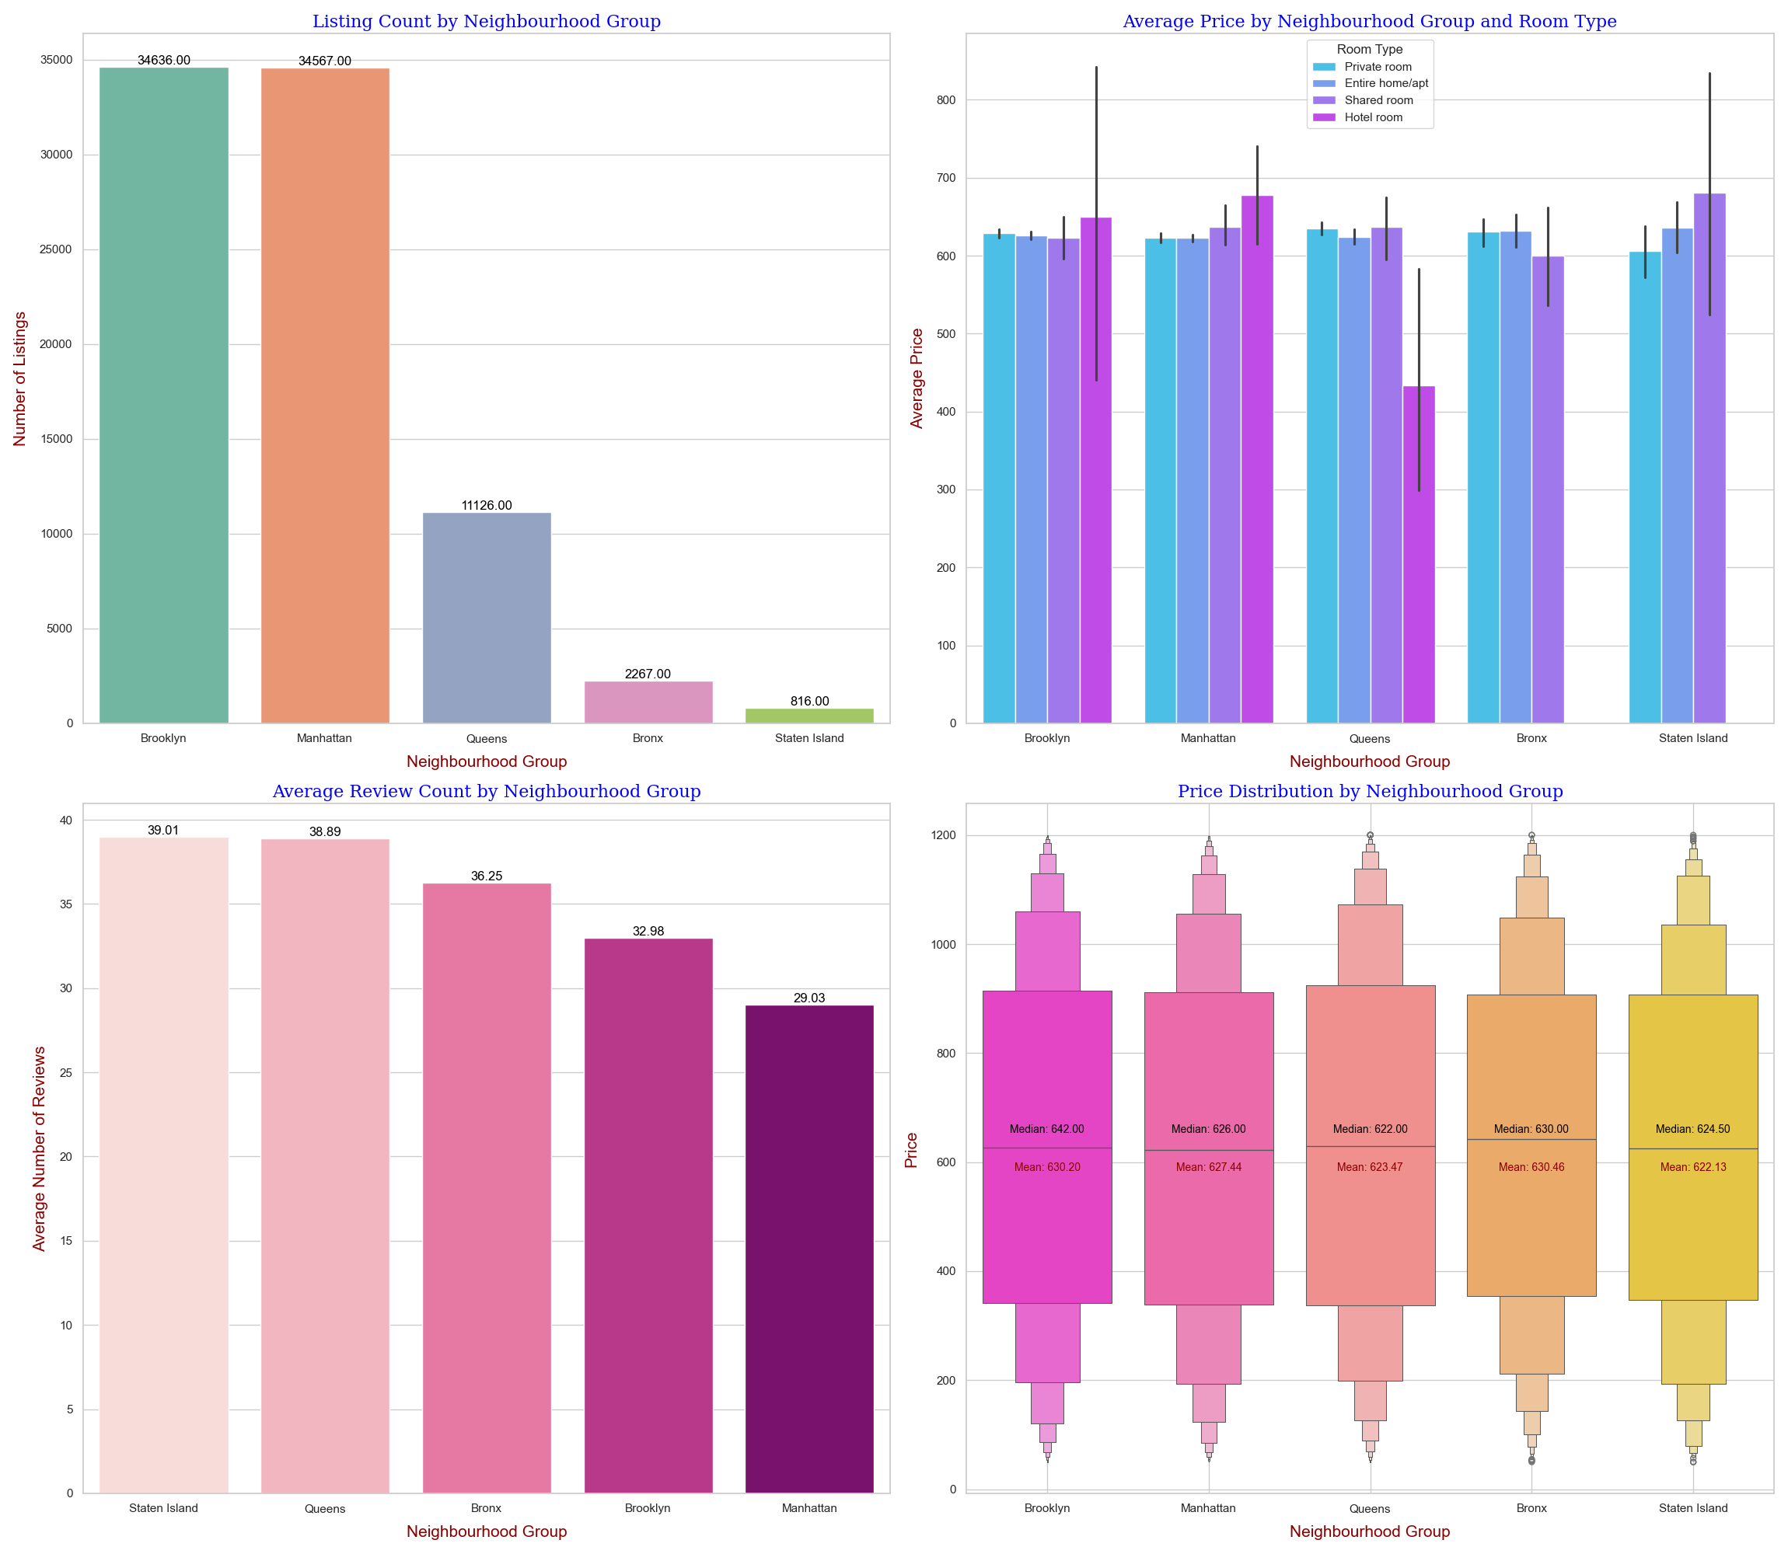

Slide 10
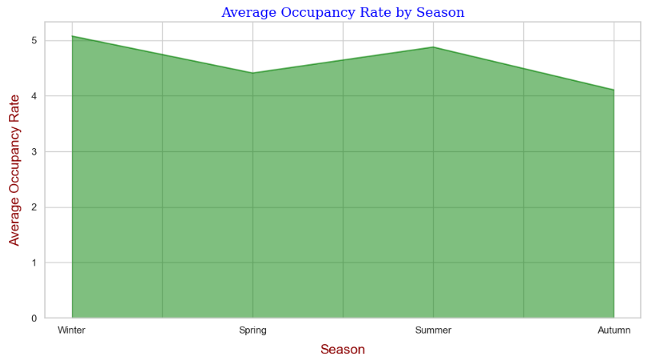
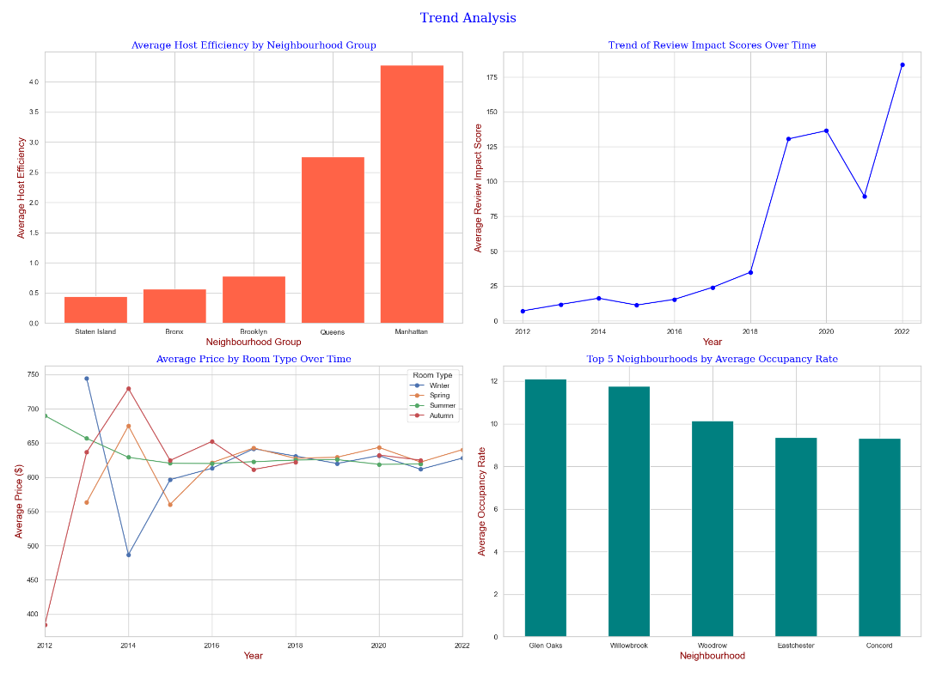
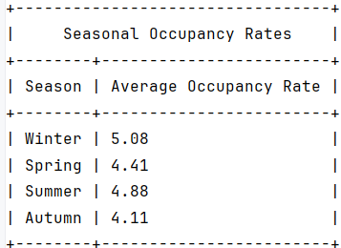

Slide 11
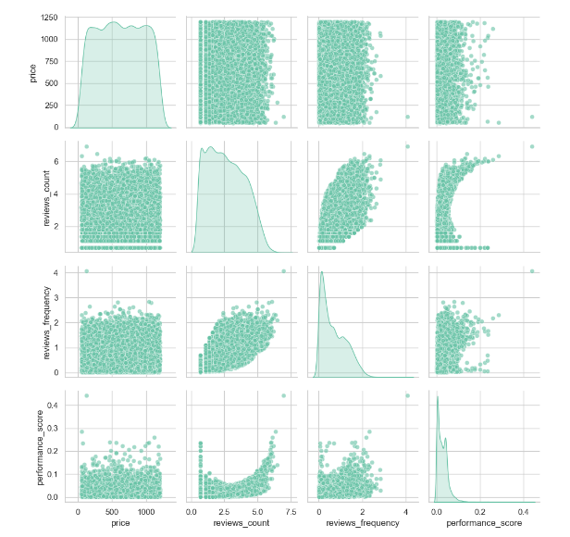
Pair Plot

Slide 12
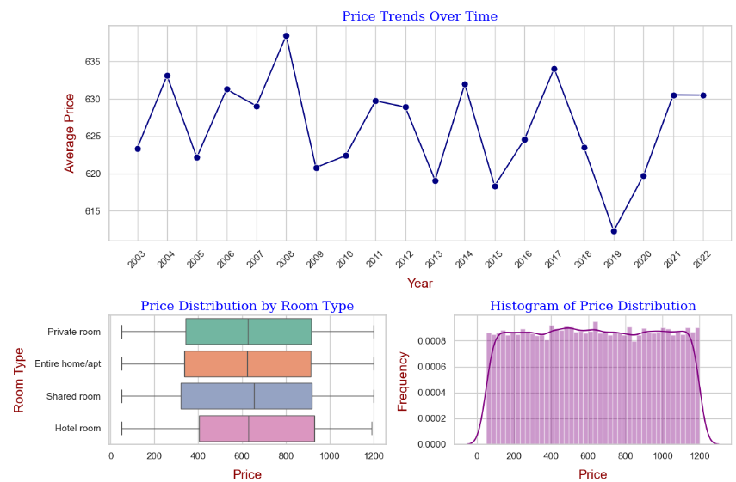
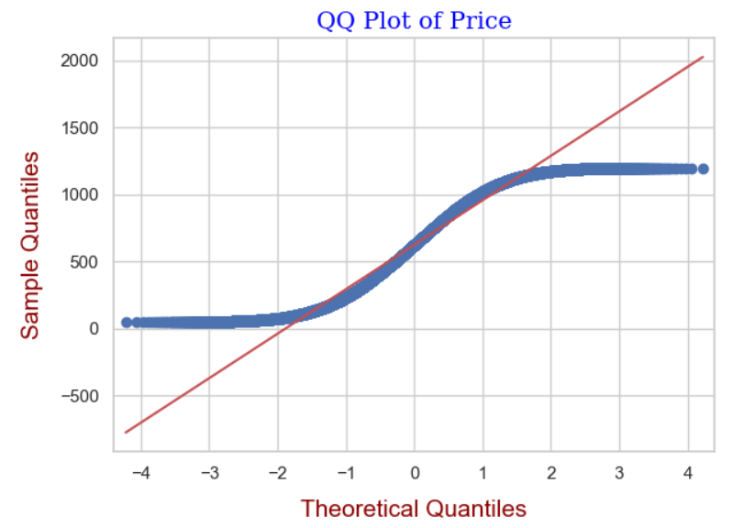
07

Slide 13
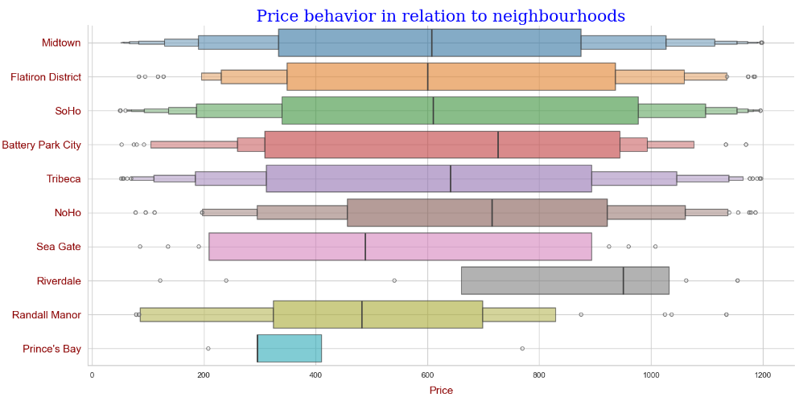
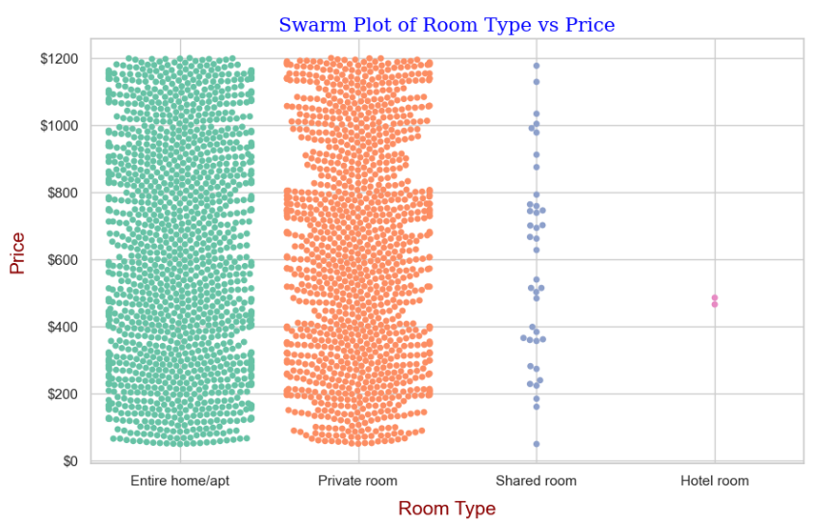
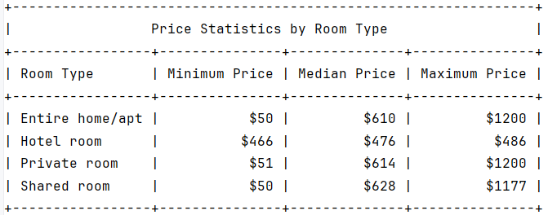
06

Slide 14
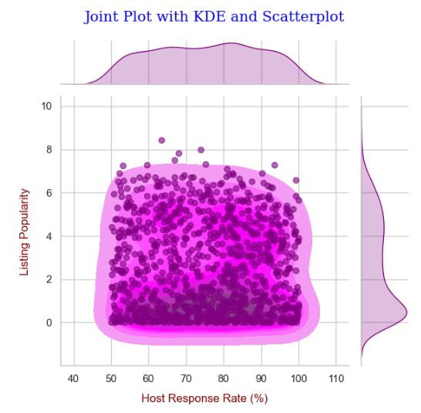
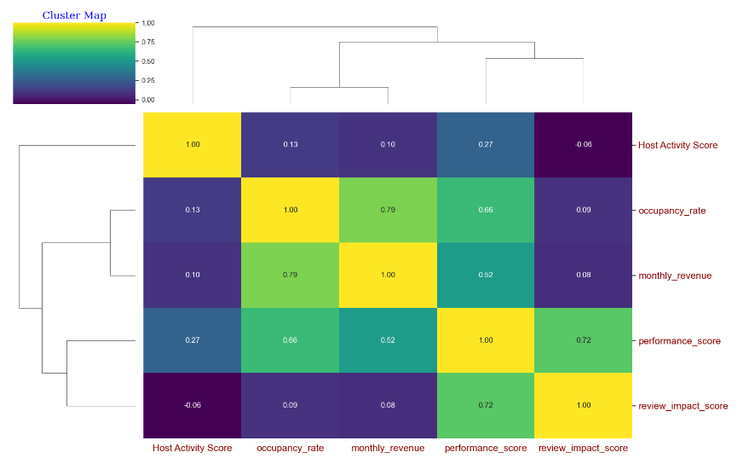

Slide 15
Conclusion
Manhattan and Brooklyn dominate Airbnb listings, reflecting host preference.
Entire homes/apartments are popular, indicating a preference for privacy among guests.
Williamsburg and Bedford-Stuyvesant are highly rated and popular neighborhoods.
Hotel rooms have high guest satisfaction, despite fewer listings.
Pricing varies widely, challenging the notion of Airbnb as always costlier.
Host activity shows weak correlation with revenue.
Positive reviews moderately influence listing popularity.
Higher occupancy drives revenue for NYC Airbnb hosts.

Slide 16
Dashboard
https://dashapp-zxxyphmjaq-ue.a.run.app

Slide 17
Thank You

